Slide 1
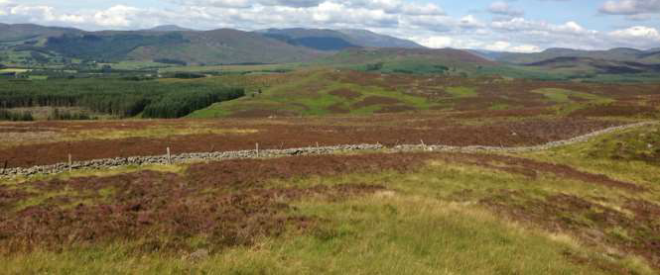
West Grampian Deer Management Group

Slide 2
DEER CODE
ECONOMIC
ENVIRONMENTAL
DEER WELFARE
DEER MANAGEMENT PLAN
POPULATION MODEL
INFORMATION:
READILY AVAILABLE – ACROSS ALL MEMBERS
EASY TO COLLECT/UPDATE
MEANINGFUL
FUTURE DIRECTION/DMP IMPLEMENTATION

Slide 3
WGDMG DEER MANAGEMENT PLAN
To have reduced deer numbers in both Sub Groups to reduce localised deer impacts across the DMG
resulting in both conservation and sustainable deer management objectives being met;
To have implemented DMG wide Habitat Monitoring of Heather Moorland and Blanket Bog to help
inform future management;
To have implemented management to ensure Designated Sites are in Favourable/Unfavourable
Recovering Due to management status;

Slide 5
AVERAGE VEGETATION HEIGHT (cm)
2007 | 18
2011 | 17.5
2017 | 15.6

Slide 6
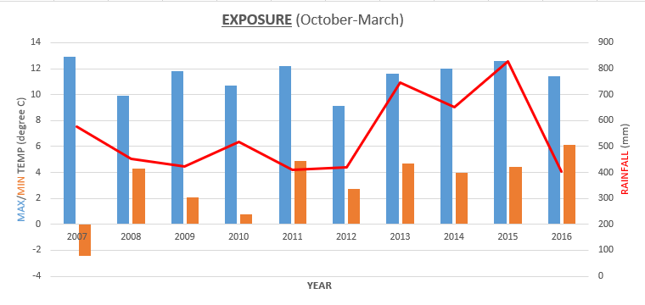
EXPOSURE (Oct - Mar)
 | Temp Range C | AFD | Rain (mm)
2007 | 12.9/-2.4 | 87 | 577.8
2008 | 9.9/4.3 | 90 | 452.8
2009 | 11.8/2.1 | 104 | 424.4
2010 | 10.7/0.8 | 104 | 519.2
2011 | 12.2/4.9 | 67 | 411.6
2012 | 9.1/2.7 | 110 | 420
2013 | 11.6/4.7 | 63 | 747.2
2014 | 12.0/4.0 | 83 | 651.2
2015 | 12.6/4.4 | 84 | 827.4
2016 | 11.4/6.1 | 91 | 403.2

Slide 7
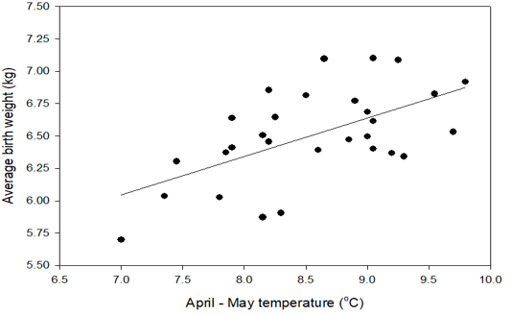
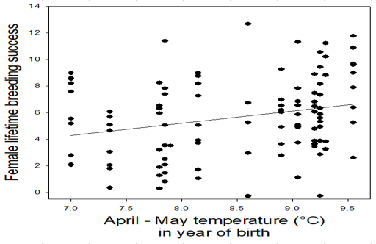

Slide 8
ATHOLL POPULATION MODEL (40%/33% RECRUITMENT)
 | Stags | Hinds | Calves | Total | Density | Stag:Hind
Counted pop 2017 (SNH HELI COUNT) | 3142 | 3424 | 1246 | 7812 | 23
Pop post natural mortality in winter/spring | 3142 | 3424 | 1246
Recruitment to adult pop on 1st June |  |  | 1370
Pre cull pop July 2017 | 3827 | 4109 | 1644 | 9579
Cull 2017/18 Planned | 420 | 1000 | 400 | 1820
Estimated pop 2018 | 3407 | 3109 | 1244 | 7759 | 22.8 | 1.1
Pop post natural mortality in winter/spring | 3373 | 3078 | 1181
Recruitment to adult pop on 1st June |  |  | 1231
Pre cull pop July 2018 | 3988 | 3693 | 1477 | 9159
Cull 2018/19 | 420 | 800 | 400 | 1620
Estimated pop 2019 | 3568 | 2893 | 1077 | 7539 | 22.2 | 1.2
Pop post natural mortality in winter/spring | 3533 | 2864 | 1023
Recruitment to adult pop on 1st June |  |  | 1146
Pre cull pop July 2019 | 4105 | 3437 | 1375 | 8918
Cull 2019/20 | 420 | 800 | 400 | 1620
Estimated pop 2020 | 3685 | 2637 | 975 | 7298 | 21.5 | 1.4
Pop post natural mortality in winter/spring | 3649 | 2611 | 926
Recruitment to adult pop on 1st June |  |  | 1044
Pre cull pop July 2020 | 4171 | 3133 | 1253 | 8557
Cull 2020/21 | 420 | 800 | 400 | 1620
Estimated pop 2021 | 3751 | 2333 | 853 | 6937 | 20.4 | 1.6
Pop post natural mortality in winter/spring | 3713 | 2310 | 811
Recruitment to adult pop on 1st June |  |  | 924
Pre cull pop July 2021 | 4175 | 2772 | 1109 | 8055
Cull 2021/22 | 420 | 800 | 400 | 1620
Estimated pop 2022 | 3755 | 1972 | 709 | 6435 | 18.9 | 1.9

Slide 9
WGDMG (EXCL ATHOLL) POPULATION MODEL (40% RECRUITMENT)
 | Stags | Hinds | Calves | Total | Density | Stag:Hind
Counted pop 2017 (SNH HELI COUNT) | 3035 | 4004 | 1419 | 8458 | 22
Pop post natural mortality in winter/spring | 3035 | 4004 | 1419
Recruitment to adult pop on 1st June |  |  | 1602
Pre cull pop July 2017 | 3836 | 4805 | 1922 | 10563
Cull 2017/18 Planned | 650 | 1200 | 400 | 2250
Estimated pop 2018 | 3186 | 3605 | 1522 | 8313 | 22.1 | 0.9
Pop post natural mortality in winter/spring | 3154 | 3569 | 1446
Recruitment to adult pop on 1st June |  |  | 1428
Pre cull pop July 2018 | 3868 | 4283 | 1713 | 9863
Cull 2018/19 | 700 | 800 | 400 | 1900
Estimated pop 2019 | 3168 | 3483 | 1313 | 7963 | 21.2 | 0.9
Pop post natural mortality in winter/spring | 3136 | 3448 | 1247
Recruitment to adult pop on 1st June |  |  | 1379
Pre cull pop July 2019 | 3826 | 4137 | 1655 | 9618
Cull 2019/20 | 700 | 800 | 400 | 1900
Estimated pop 2020 | 3126 | 3337 | 1255 | 7718 | 20.5 | 0.9
Pop post natural mortality in winter/spring | 3094 | 3304 | 1192
Recruitment to adult pop on 1st June |  |  | 1322
Pre cull pop July 2020 | 3755 | 3965 | 1586 | 9306
Cull 2020/21 | 700 | 800 | 400 | 1900
Estimated pop 2021 | 3055 | 3165 | 1186 | 7406 | 19.7 | 1.0
Pop post natural mortality in winter/spring | 3025 | 3133 | 1127
Recruitment to adult pop on 1st June |  |  | 1253
Pre cull pop July 2021 | 3651 | 3760 | 1504 | 8914
Cull 2021/22 | 700 | 800 | 400 | 1900
Estimated pop 2022 | 2951 | 2960 | 1104 | 7014 | 18.7 | 1.0

Slide 10
CONCLUSIONS
High hind density depresses many aspects of deer performance
Annual variation in weather generates cohorts of different size and lifetime performance
Climate change looks to be improving deer performance
All above suggests hill deer management should include regular counting and responsive culling
It is acknowledged that there is substantial variation in the environment experienced by red deer in different part of Scotland

